Slide 1
Smallpox Variola Virus
Krysta Kishbaugh

Slide 2
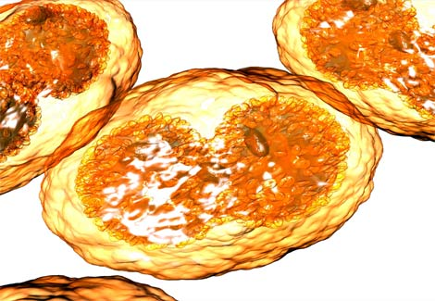
What is Smallpox?
Smallpox is an infectious, contagious & sometimes fatal disease unique only in humans.
The microbial name for Smallpox is Variola Virus.
Smallpox is caused by either of two virus variants:
Variola major
Variola minor.

Slide 3
Variola Major
Variola major is the severe and most common form of smallpox.
This highly virulent form causes toxemia, shock, and intravascular coagulation.
There are four types of Variola major smallpox:
Ordinary-most common; 90% or more
Modified-mild & occurs in previously vaccinated individuals.
Flat-rare and possibly fatal
Hemorrhagic-Rare and possibly fatal
Variola major has an overall fatality rate of about 30%!
People who survive any form of smallpox nearly always develop lifelong immunity.

Slide 4
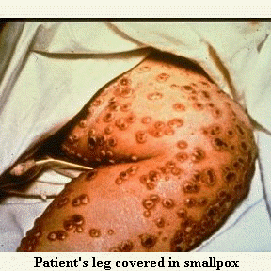
Ordinary smallpox

Slide 5
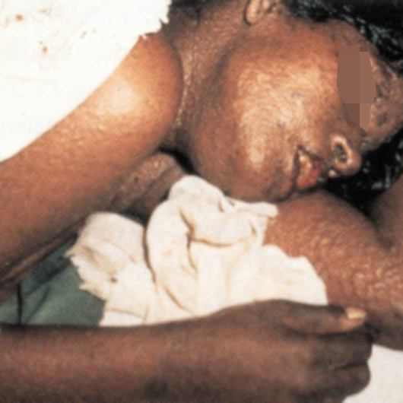
flat and hemorrhagic smallpox (usually fatal)

Slide 6
Variola Minor
Variola minor is a less common form of smallpox and is much less severe. death rates are 1% or less.

Slide 7
facts about smallpox…
The pox part of smallpox is derived from the Latin word for “spotted” and refers to the raised bumps that appear on the face and body of an infected person.
Smallpox has been around for thousands of years, but is now “the disease of the past” because of the successful worldwide vaccination program.
After the disease was eliminated from the world, routine vaccination among the general public was stopped because it was no longer necessary for prevention.

Slide 8
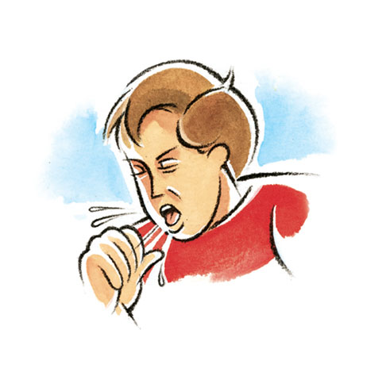
Transmission
IT CAN BE PASSED DIRECTLY THROUGH COUGHING, SNEEZING, OR BREATHING.
prolonged face-to-face contact
Smallpox also can be spread through direct contact with infected bodily fluids or contaminated objects such as bedding or clothing.
A person with smallpox becomes contagious with the onset of the rash.
The infected person is contagious until the last smallpox scab falls off.

Slide 9
Epidemiology
IN THE EARLY 1970’S: SMALLPOX WAS AN EPIDEMIC IN 31 COUNTRIES.
EVERY YEAR 10-15 MILLION PEOPLE CONTRACTED THE DISEASE AND APPROXIMATELY 2 MILLION DIED FROM IT.
The last case of smallpox in the United States was in 1949.
The last naturally occurring case in the world was in Somalia in 1977.
After September 11, 2001 and the anthrax scare with bioterrorism, the U.S. Government once again allowed certain populations to receive the vaccination.

Slide 10
SIGNS, SYMPTOMS, & STAGES
FIRST SYMPTOMS ARE CALLED PRODROME PHASE:
FEVER (101-104 DEGREES FAHRENHEIT)
MALAISE
HEAD & BODY ACHES
VOMITTING
PEOPLE ARE TOO SICK TO CARRY ON WITH THEIR NORMAL ACTIVITIES
LAST 2-4 DAYS

Slide 11
SIGNS, SYMPTOMS, & STAGES
SECOND STAGE IS EARLY RASH:
THIS STAGE LAST UP TO 4 DAYS
MOST CONTAGIOUS STAGE
A RASH EMERGES AS SMALL RED SPOTS ON THE TOUNGE AND IN THE MOUTH
These spots develop into sores that break open and spread large amounts of the virus into the mouth and throat. At this time, the person becomes most contagious.
Now the rash will start to appear on the skin; starting on the face, then the arms, legs, and finally hands and feet.
Rash spreads through the whole body within 24 hours
On the third day the rash turns into bumps
On the fourth day the bumps fill with thick fluid

Slide 12
SIGNS, SYMPTOMS, & STAGES
THIRD STAGE IS PUSTULAR RASH:
LAST ABOUT 5 DAYS
INDIVIDUAL IS STILL CONTAGIOUS
The bumps NOW become pustules—sharply raised, usually round and firm to the touch
FOURTH STAGE IS PUSTULES AND SCABS:
LAST ABOUT 5 DAYS
INDIVIDUAL IS STILL CONTAGIOUS
The pustules begin to form a crust and then scab.
By the end of the second week after the rash appears, most of the sores have scabbed over

Slide 13
SIGNS, SYMPTOMS, & STAGES
FINAL STAGES ARE SCABBING:
LAST ABOUT 6 DAYS
INDIVIDUAL IS CONTAGIOUS UNTIL THE FINAL SMALLPOX SCAB FALLS OFF
The scabs begin to fall off, leaving marks on the skin that eventually become pitted scars
Most scabs will have fallen off three weeks after the rash appears.

Slide 14
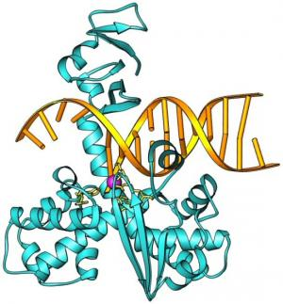
Diagnosis
IF A PERSON IS SUSPECTED OF HAVING SMALLPOX IT IS AN INTERNATIONAL EMERGENCY
SPECIALIZED LABORATORY TESTING IS NECESSARY
SPECIALIZED DOCTORS TAKE FLUID SAMPLES FROM THE INDIVIDUALS MOUTH OR FROM THE SUSPECTED SMALLPOX LESIONS
SEALED SAMPLES ARE SHIPPED TO THE CDC OR ANOTHER EQUIPPED LABORATORY
IN THE LABORATORY THEY CAN QUICKLY IDENTIFY THE VARIOLA VIRUS BY USING AN ELECTRON MICROSCOPE, VIRUL CULTURE, AND VARIOUS TESTS TO IDENTIFY THE DNA OF THE VIRUS.

Slide 15
Treatment
There is no treatment for smallpox
After symptoms start, treatment consists of supportive medical care, including giving the person fluids to prevent dehydration and medicines to control pain and fever
Isolating the person until all the scabs have fallen off-about 3 to 4 weeks after the rash first appears-is necessary to prevent spreading the infection to others

Slide 16
prevention
Vaccination:
The smallpox vaccine is the only known way to prevent smallpox if a person is exposed.
When given within 3 days of exposure, the vaccine can prevent or greatly reduce the severity of smallpox symptoms in most people.
Getting a shot 4 to 7 days after exposure may also help.
The smallpox vaccine is made from the vaccinia virus, which is similar to variola virus, but safer. The vaccinia virus does not cause smallpox illness.

Slide 17
sources
Center for Disease Control & Prevention: http://www.bt.cdc.gov/agent/smallpox/overview/disease-facts.asp
WebMD:
http://www.webmd.com/a-to-z-guides/smallpox topic-overview
Microbiology: A Systems Approach

